Slide 1
Introduction To Blockchain Technology
Making The World Decentralized

Slide 2
Agenda
01
Introduction
02
How Does it Works
03
Advantages of Blockchain
04
Real-world applications of Blockchain
05
Limitations and challenges
06
Conclusion

Slide 3
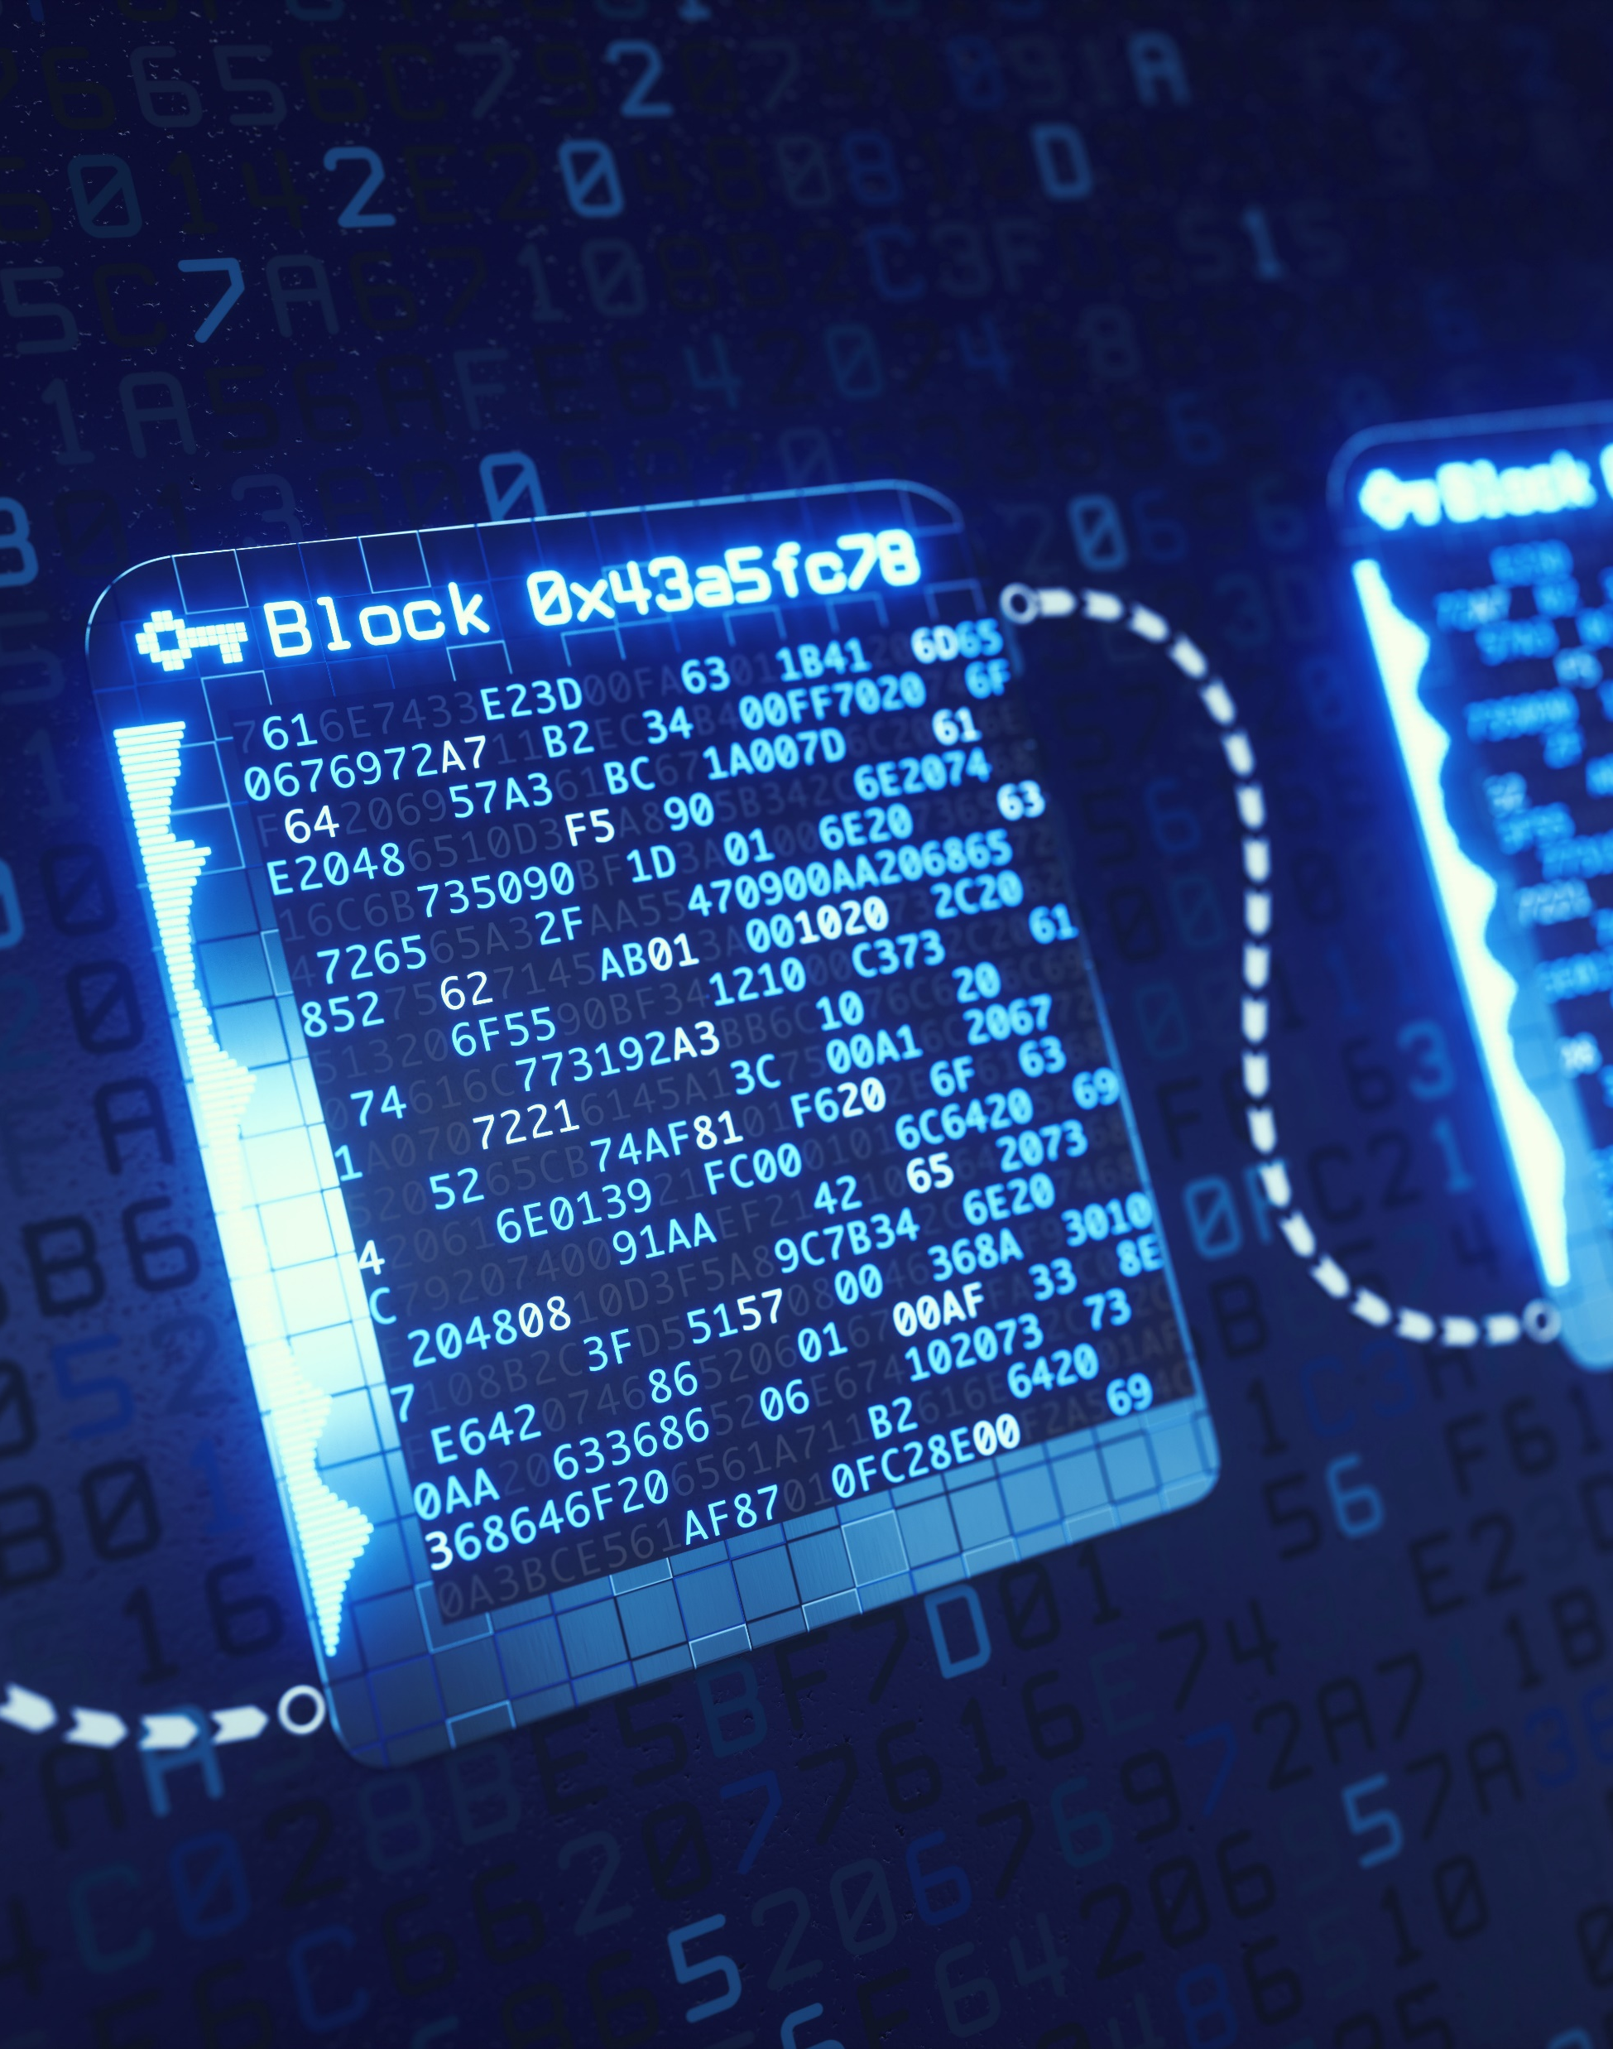
Introduction
What is Blockchain ?
Blockchain is a new type of technology based on distributed ledger that allows us to record and track transactions in a safe and transparent way. It was first created for Bitcoin, which is a type of digital currency.
Historical background and evolution
Different Crypto Volumes
Blockchain was invented in 2008 by an anonymous person or group of people behind the online cash currency Bitcoin using the pseudonym "Satoshi Nakamoto". Since then, blockchain has evolved and been used for many different purposes.
Bitcoin
Ethereum
Tether
Others

Slide 4
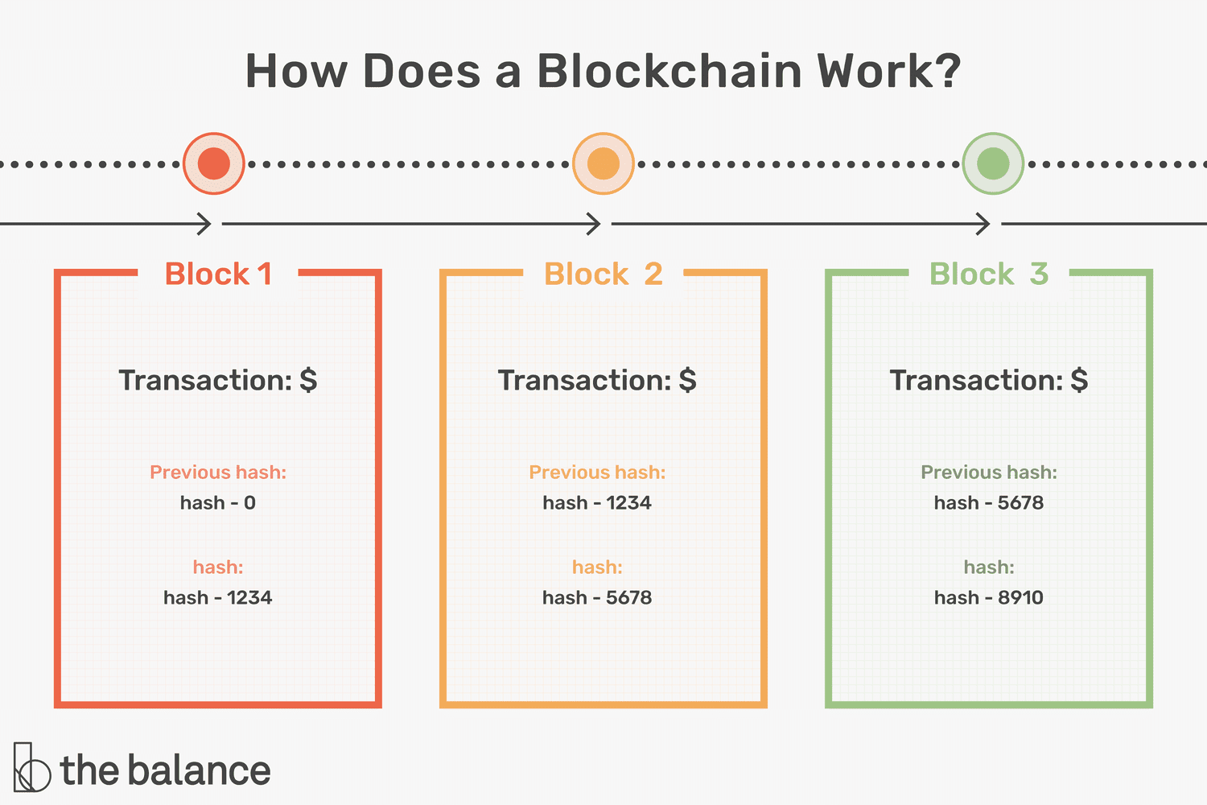
How Blockchain works ?
A blockchain is made up of blocks, which contain transaction data. These blocks are connected to each other in a chain-like structure, which creates a permanent record of all the transactions on the blockchain. Nodes are computers or devices that work together to verify and process transactions on the blockchain
Multiple Blocks Connected together

Slide 5
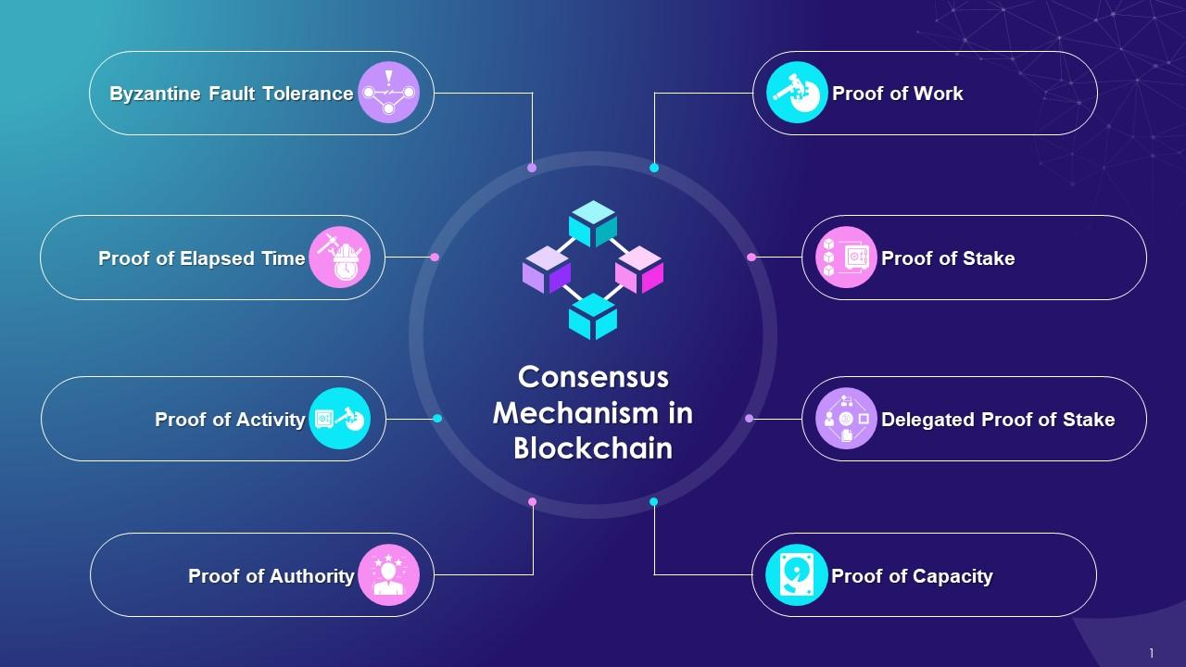
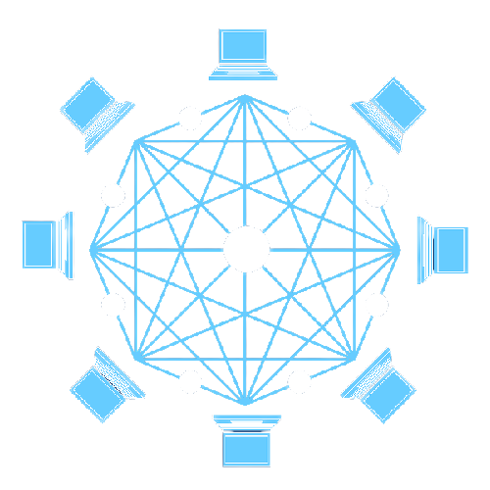
Consensus mechanisms
Consensus mechanisms and their role in maintaining the integrity of the blockchain Consensus mechanisms are used to make sure that everyone in the network agrees on the state of the blockchain. There are different types of consensus mechanisms like
PoW (Proof of work)
PoS (Proof of stake)
PoC (Proof of capacity)
but they all work towards the same goal - to maintain the integrity and security of the blockchain

Slide 6
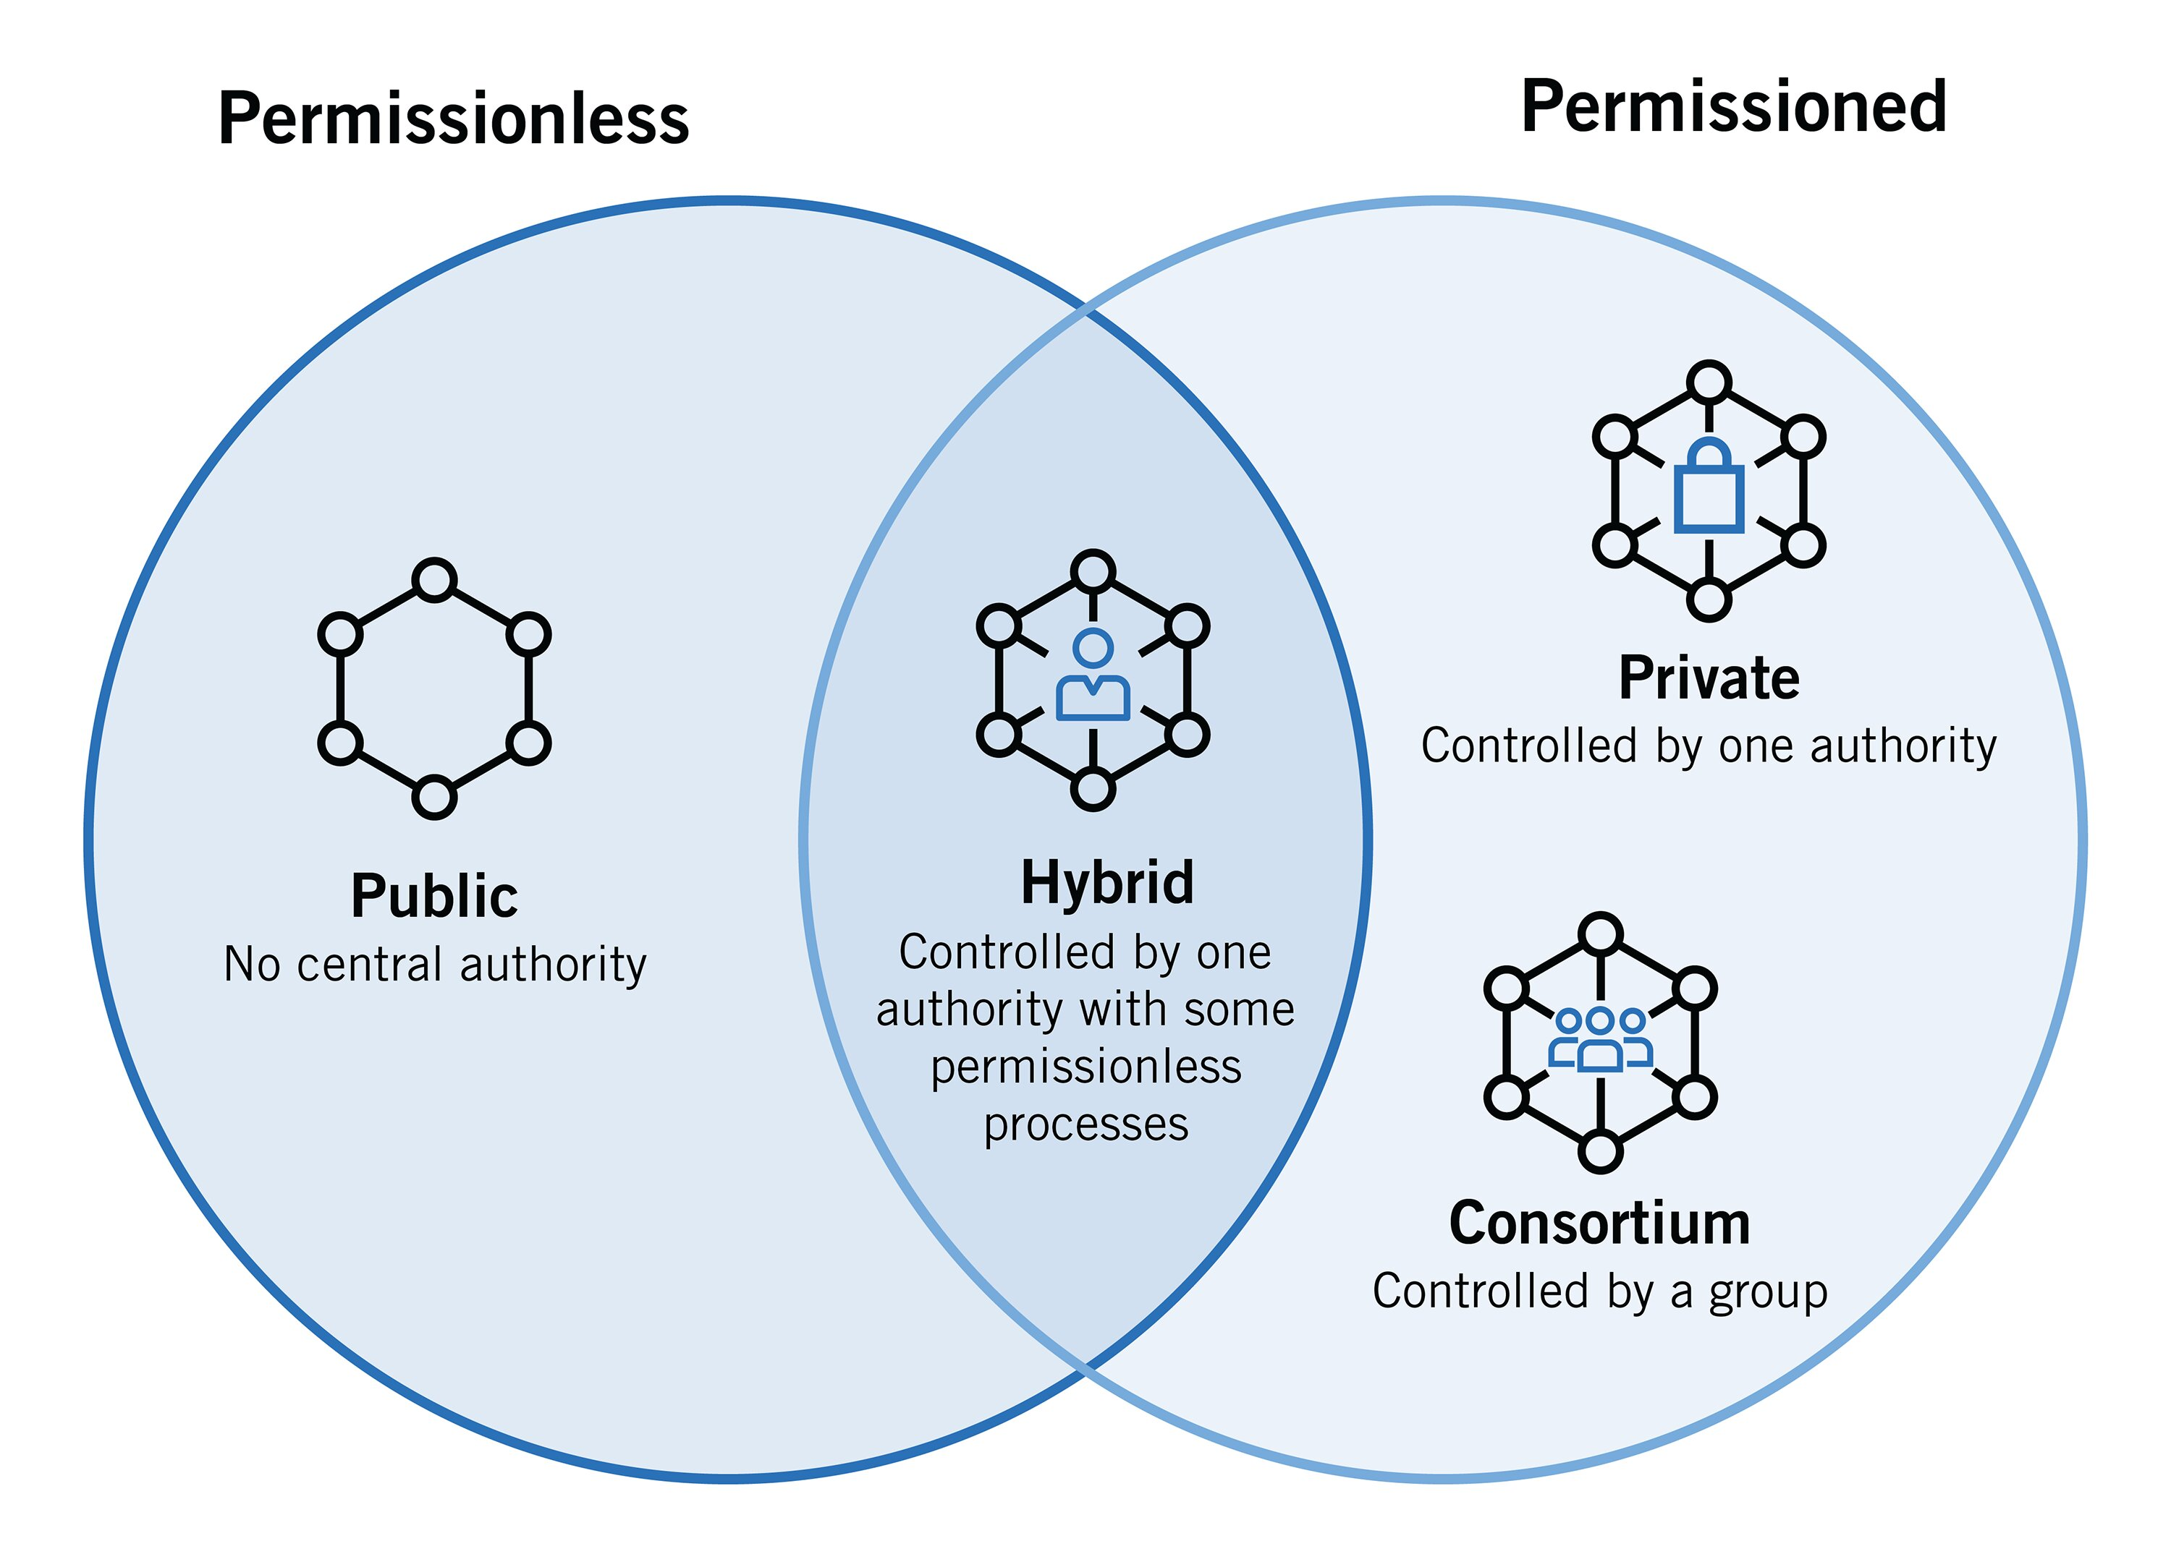
Types of Blockchain
01
Public Blockchain
Public blockchains are open to anyone.
02
Private Blockchain
Private blockchains are only accessible to certain people or organizations
03
Consortium Blockchain
privately owned but not by a single entity or individual.
04
Hybrid Blockchain
Hybrid of public and private both blockchains

Slide 7
Advantages of Blockchain
Transparency and immutability
Security
Transactions on a blockchain are visible to everyone, and once they are recorded, they cannot be altered or deleted. This makes the blockchain a transparent and trustworthy record of transactions.
Blockchain uses cryptography to protect transactions, making them very secure. Personal information can also be stored securely on the blockchain
Decentralization
Privacy
Blockchain is decentralized, which means that there is no single person or organization in control of it. This reduces the risk of fraud and hacking.
blockchain provides privacy by encrypting data and ensuring that only authorized parties have access to it. This makes blockchain a secure and trustworthy way to store and share sensitive information.

Slide 8
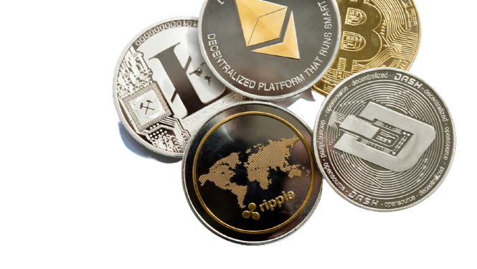
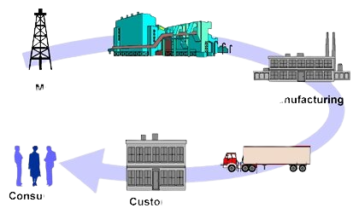
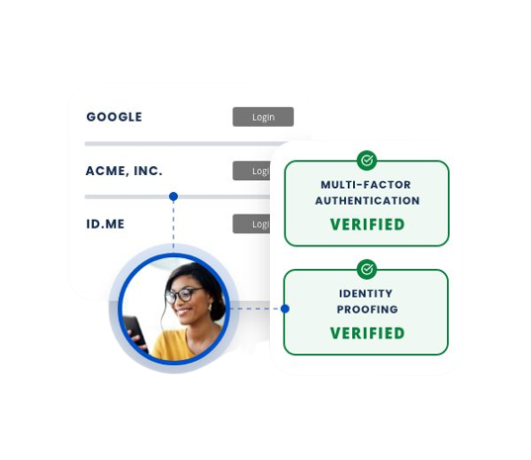
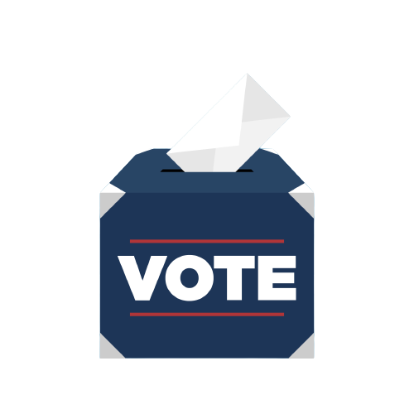
Real-World Applications of Blockchain
Cryptocurrencies and digital assets: Blockchain is often used for cryptocurrencies like Bitcoin, as well as other digital assets.
Supply chain management: Blockchain can be used to track products and ensure that they are genuine and have not been tampered with.
Identity verification and authentication: Blockchain can be used to store and share personal information securely.
Voting and governance: Blockchain can be used to create transparent and secure voting systems.

Slide 9
Limitation and Challenges
Scalability issues: It can be difficult to scale the blockchain without compromising security or decentralization.
Energy consumption and environmental concerns: The consensus mechanisms used by blockchain require a lot of energy, which can be environmentally damaging.
Regulatory challenges and legal implications: There are still many legal and regulatory challenges to be addressed as blockchain technology continues to evolve.
Lack of Technical Expertise: As Blockchain technology is merging field so there is a lack of expertise of people in it yet
.
Scalability issues
Energy consumption
Regulatory challenges
Legal implications
Environmental concerns
Lack of technical expertise

Slide 10

Conclusion
Blockchain technology has the potential to revolutionize many industries by providing secure and transparent record-keeping. While there are still challenges to overcome, the benefits of blockchain technology are significant and far-reaching.

